Slide 1
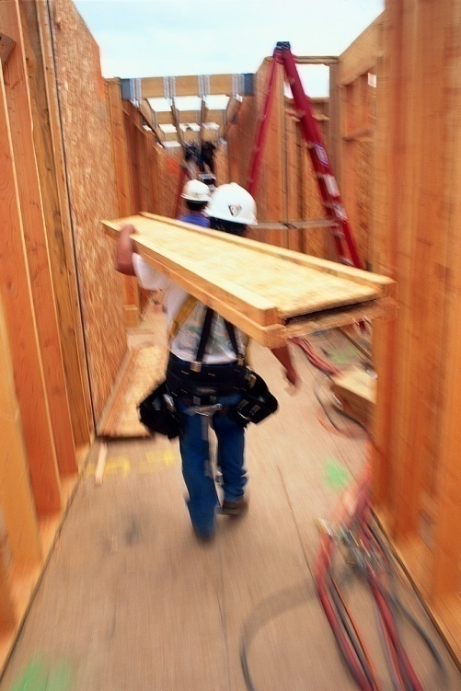
“HOUSE BUILDING”
Which standard of measurement?
?
Notes:
If you want to build a house according to a specified blue print, would you bid out a contractor who uses a tape measure as the standard of measurement, one who believes that twelve inches equal a foot and three feet equal a yard? One who believes in and adheres to the blueprint pattern and dimensions?
Or would you bid it out to one who rejects the tape measure as being outdated, too traditional, old fashioned and too rigid and judgmental. Would you bid it out to a contractor who looks at measuring things subjectively, that is, he just kind of “eyes” and goes with what he feels it should be. Perhaps he believes that the "12 inches equaling a foot" doctrine is just an opinion and ought not be followed and the blueprint with the specifications in them is useless.
What kind of contractor would you want to have build your house? What about a third kind of contractor who believes in using the tape measure "sometimes" but then also believes in fellowshipping the “eyeing” of things too? What about one who sometimes will go by your blueprints and then other times ignore it?

Slide 2

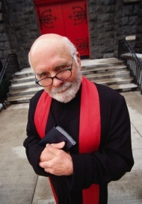
“FAITH BUILDING”
Which standard of measurement?
?
+
(Rom. 10:17)
bible + tradition +
man’s word
bible + nothing
Notes:
What about “faith building?” If we understand that we would not want one’s subjectivism in measuring and building a house of wood and stone, why would we want a person’s subjective opinion in helping us build faith?
Do we want preachers ministering to us the Bible as it is, or do we want ministers who repudiate the infallibility of the scriptures and endorses the opinions of man? Do we want a minister who will sometimes believe in the Bibles blueprint and at other times ignore it? These are the kind of faith builders that churches can choose from today.
But when it is all said and done, "so then faith comes by hearing and hearing by the word of God" (Rom. 10:17).

Slide 3
“CHURCH BUILDING”
Which standard of measurement?
?
+
(Col. 3:17
Matt. 28:18)
bible + tradition +
creeds
New Testament as Rule of Faith
Notes:
People build churches (and I am not speaking of the physical structure that houses the church, but the congregation) the same way they are content to build their faith. It is either built being based upon the word of God alone, or a mixture of the word with man’s assumptions, man’s education, man’s thinking, man’s creeds, parents faith, grand-parents faith, popularity, proximity of the church building, likeability of the preacher, members, etc.
You really need to ask yourself why do you worship where you worship? Is your faith something that you inherited or was it found through a diligent and personal study of scripture?
When it comes to building a church, it is just “a church” if it is not built on the New Testament alone.
“And whatever you do in word or deed, do all in the name of the Lord Jesus, giving thanks to God the Father through Him” (Col. 3:17). Why does Paul tell us to do all in the name of the Lord Jesus? It is because Jesus has all authority in heaven and on earth (Matt. 28:18) and "Lord of lords and King of kings" (Rev. 17:14).
That leaves none for Moses or David. The Law and the prophets pointed toward the Christ that we should believe on him and obey his word (cf. Deut. 18:18, 19; Acts 7:37).

Slide 4

The Lord’s Church
built at the right time: ~33 AD (Acts 2:47)
built in the right place: Jerusalem (Acts 1:4; 2:5)
built by the right person: Jesus (Matt. 16:18)
uses the right rule: New Testament (Heb. 12:24)

Slide 5
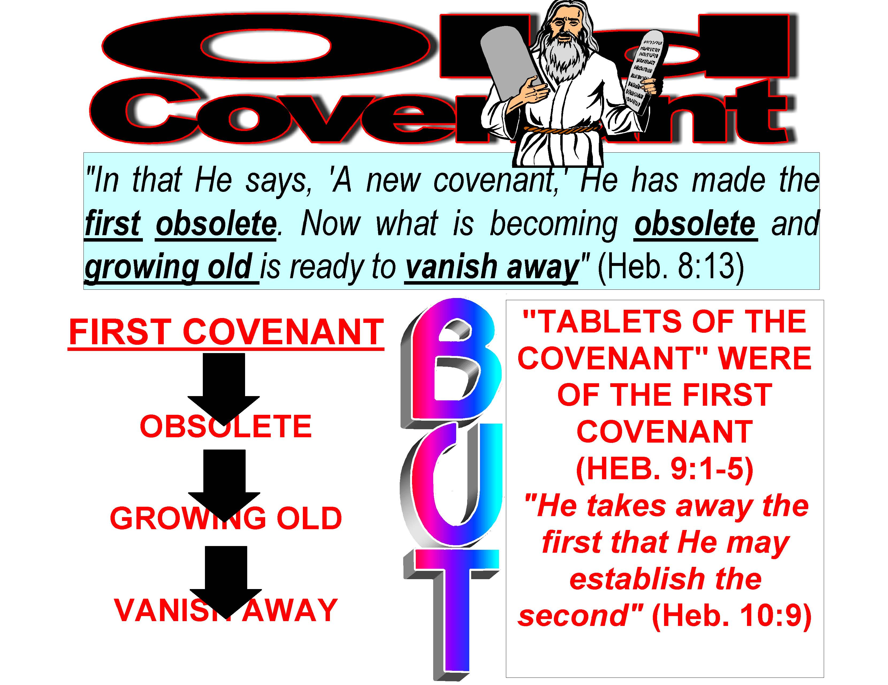

Slide 6
The Lord’s Church
built at the right time: ~33 AD (Acts 2:47)
built in the right place: Jerusalem (Acts 1:4; 2:5)
built by the right person: Jesus (Matt. 16:18)
uses the right rule: New Testament (Heb. 12:24)
worships correctly: spirit and truth

Slide 7
WORSHIPS IN SPIRIT AND TRUTH
“²² You worship what you do not know; we know what we worship, for salvation is of the Jews. ²³ But the hour is coming, and now is, when the true worshipers will worship the Father in spirit and truth; for the Father is seeking such to worship Him. ²⁴ God is Spirit, and those who worship Him must worship in spirit and truth” (Jn. 4:22-24)
Right One
Right Way
Right Mind
Notes:
Contextually, Jesus is speaking to a Samaritan woman. The Smaratians had a form of worship as the Jews did but it was wrong; It was not true worship. There is a wrong and a right religion. Jesus is looking toward the would be church soon to be built to worship God with the right attitude and in the right way. We should be impressed that Jesus said right worship is a must.
[CLICK] Worship must be directed to the right object, with the right mind and in the right way! If it is not of such, it is rendered as “vain worship”

Slide 8
TRUTH & SPIRIT
Collection:
  only on first day of the week (1 Cor. 16:1:2)
  if the day is unimportant, why did Paul specify the first day?
Lord’s Supper:
  on every and only the first day of the week (Acts 20:7)
  the New Testament church came together on the first of the week to partake of the LS, when does the church where you are a member partake of the LS?
  no church-sponsored carnal meals (1 Cor. 11:22, 34)
Notes:
[CLICK thru]

Slide 9
TRUTH & SPIRIT
Preaching: Acts 20:7
Prayer: Acts 2:42
Singing: without mechanical instruments
  if you think it really doesn’t matter…
    note that instrumental music in congregational worship was not in the first several hundred years of church history
    it was always opposed when initially added into congregations
    most denominational founders opposed it
    God destroyed people who changed His worship
    (Lev. 10:1-5)
Notes:
[CLICK thru]

Slide 10
Song in Truth & Spirit
worship
“speaking to one another in psalms and hymns and spiritual songs, singing and making melody in your heart to the Lord” (Eph. 5:19, NKJV)
  who are we supposed to speak to?
  what are we supposed to speak?
  how are we supposed to speak it?
  what are we to make melody in?
  where is authority for playing an instrument as worship in the New Testament?

Slide 11
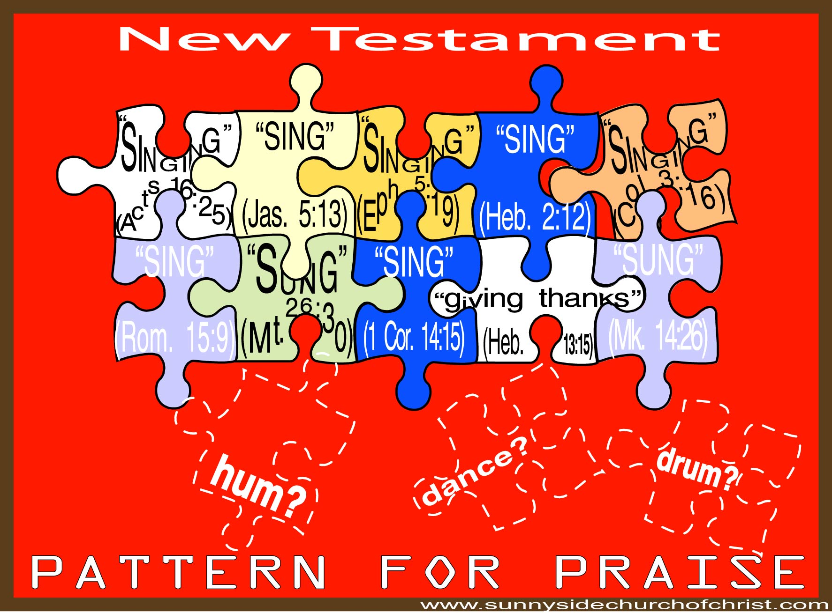
Notes:
You can find several verses to authorize a cappella music in the New Testament, but none for mechanical, none for humming and none for dancing. The fact that some find mechanical instruments in the Old Testament system doesn’t help them authorize it anymore than finding burning incense, Sabbath-keeping, and animal sacrifices under the Old Testament would authorize one to place such in the New Testament church TODAY.
Some respond, “But Jesus took animal sacrifices away with His own sacrifice.” The Bible doesn’t say that he just took animal sacrifices away. He took the whole kit and cabudal away.
Hebrews 7:18, 19, “For on the one hand there is an annulling of the former commandment because of its weakness and unprofitableness, for the law made nothing perfect; on the other hand, there is the bringing in of a better hope, through which we draw near to God.”
Heb 8:8 Because finding fault with them, He says: "Behold, the days are coming, says the LORD, when I will make a new covenant with the house of Israel and with the house of Judah—
Heb 8:9 "not according to the covenant that I made with their fathers in the day when I took them by the hand to lead them out of the land of Egypt; because they did not continue in My covenant, and I disregarded them, says the LORD.
Heb 8:13 In that He says, "A new covenant," He has made the first obsolete. Now what is becoming obsolete and growing old is ready to vanish away.
Heb 10:9 then He said, "Behold, I have come to do Your will, O God." He takes away the first that He may establish the second."
It is because of the silence of God on allowing instrumental music that the church did not practice praise with such for the first 700 years after Christ.
Jas. 5:13, ". . .Is anyone cheerful? Let him sing psalms."
Heb. 2:12, "In the midst of the assembly I will sing praise to You."
Rom. 15:9, "For this reason I will confess to You among the Gentiles, And sing to Your name."
Col. 3:16, "Let the word of Christ dwell in you richly in all wisdom, teaching and admonishing one another in psalms and hymns and spiritual songs, singing with grace in your hearts to the Lord."
Matt. 26:30, "And when they had sung a hymn, they went out to the Mount of Olives.
1 Cor. 14:15, ". . .I will sing with the spirit, and I will also sing with the understanding."

Slide 12
Are Not the “Psalms”
To Be PLAYED?

Slide 13
The Lord’s Church
built at the right time: ~33 AD (Acts 2:47)
built in the right place: Jerusalem (Acts 1:4; 2:5)
built by the right person: Jesus (Matt. 16:18)
uses the right rule: New Testament (Heb. 12:24)
worships correctly: spirit and truth (Jn. 4:23, 24)
is organized the right way

Slide 14
Is Organized the Correct
Way
each local church is “self-governing”
  autonomous
    able to make decisions; able to act decisively as a free and independent body
    doesn’t need authority from another congregation to act
    is never independent from the law of Christ
Notes:
Autonomous – without outside control and having the right to act independently, self-governing; the etymology is auto (self) +nomos (law) =self law.

Slide 15
Is Organized the Correct Way
each local church is “self-governing”
  autonomous
  elders (also called pastors and bishops) and deacons when men meet the qualifications of such
    uses scriptural terms in a scriptural way
CHRIST
ELDERS
MEMBERS DEACONS
LOCAL
CONGREGATION
Notes:
Elders rule under Christ and all other Christians serve under them. It is not that elders have legislative power, but they do have the rule and oversight of the congregation. Philippians 1:1.

Slide 16
Acts 14:23
“So when they had appointed elders in every church, and prayed with fasting, they commended them to the Lord in whom they had believed” (NKJV)
there were appointed a plurality of elders in every single church!
  NOT one elder over one church
  NOT one elder over many churches
  NOT an eldership over many churches
  TWO OR MORE elders over one church

Slide 17
BIBLE TERMS, FALSE USES
“ELDER”
NOT A MORMON ELDER
  TOO YOUNG
  NO CHILDREN
“BISHOP”
NOT A CATHOLIC BISHOP
  NOT MARRIED
  NO CHILDREN
  OVER TOO MANY CHURCHES
  NO ELDERSHIP
“PASTOR”
NOT A PROTESTANT PASTOR
  TOO MUCH POWER
  NO ELDERSHIP
Notes:
Mormon Elder – contradict Titus 1:5-6
Catholic Bishop – contradict Titus 1:5-7; 1 Tim. 4:14 (eldership) or presbytery, council of elders (Acts 22:5); deal with the too many churches in the next chart.
Protestant Pastor. I went out to eat with Jim and Mary. On the way there I notice signs welcoming the First Baptist Church Northwest Convention so after I ate I thought I could spot some with great probability as being members of this convention. I asked them if they were a part of it and they quickly said yes. I asked them what goes on in the convention and they said it was mainly to encourage people, share ideas and help with organization. I then asked them if it was a law determining convention and one said no and the other said yes. Then I asked them what do they do there and they blurted out “We’re pastors.” I was pressed for time and had to get going to the Bible study so I wasn’t able to stick around and get into anything deeper. One of them asked me if I was a “pastor” and I said, “No, I am an evangelist for the church of Christ” which then brought on the remark, “Well, we are glad to see that you are in the business of teaching people about Jesus.” I thought, “Yeah, the true Jesus.”
Webster correctly defines Pastor as a spiritual overseer. Unfortunately, however, you will not find a New Testament pastor acting alone as the overseer of the church. He is the same as the elder and bishop.

Slide 18
1 Pet. 5:1-4
elder Gk. presbuteros
pastor Gk. poimaino
bishop GK. episkopeo
¹ The elders who are among you I exhort, I who am a fellow elder and a witness of the sufferings of Christ, and also a partaker of the glory that will be revealed: ² Shepherd the flock of God which is among you, serving as overseers, not by compulsion but willingly, not for dishonest gain but eagerly; ³ nor as being lords over those entrusted to you, but being examples to the flock; ⁴ and when the Chief Shepherd appears, you will receive the crown of glory that does not fade away.
(NKJV)
Notes:
[CLICK] note the plurality. He is addressing the elders which are plural among you, or the congregation where you are. [CLICK]
[CLICK] Note that the elders are commanded to “shepherd” which is the verb form of the Greek word for Pastor (the noun is used in Eph. 4:11 and the verb is used here). Elders are to pastor the flock. [CLICK] Notice they are to do it as “overseers” which is the same word that is used in 1 Timothy 3: and translated as “bishop.”
[CLICK] The comprehensive and irrefutable point is this, elders are pastors are bishops! They are all one and the same.
presbuteros [pres-boo’-ter-os]
poimaino [poy-mah’-ee-no]
episkopeo [ep-ee-skop-eh’-o]

Slide 19
The Lord’s Church
built at the right time: ~33 AD (Acts 2:47)
built in the right place: Jerusalem (Acts 1:4; 2:5)
built by the right person: Jesus (Matt. 16:18)
uses the right rule: New Testament (Heb. 12:24)
worships correctly: spirit and truth (Jn. 4:23, 24)
is organized the right way (Acts 14:23)
members wear scriptural designations

Slide 20
Members Wear Scriptural
Designations
Ac 11:26, “And when he had found him, he brought him to Antioch. So it was that for a whole year they assembled with the church and taught a great many people. And the disciples were first called Christians in Antioch” (NKJV)
not Baptists
not Catholics
not Presbyterians
not Pentecostals
not Lutherans
just Christians
ROMANS 16:16
Notes:
These other names cannot be said of faith because the Bible never speaks of them. It speaks of John the Baptist, but not “Baptists.” Further, John is not the founder of the church. Likewise, the Bible speaks of “Pentecost” but not “Pentecostals.” Why name a church after a Jewish feast?
Should some be call “Unleavened Breadals,” “Passoverians?”
These other names cannot create unity because they are all names started by man and circulate around man-made doctrine. The only name where unity can be found and Christ can be honored is in “Christian.”

Slide 21
The Lord’s Church
built at the right time: ~33 AD (Acts 2:47)
built in the right place: Jerusalem (Acts 1:4; 2:5)
built by the right person: Jesus (Matt. 16:18)
uses the right rule: New Testament (Heb. 12:24)
worships correctly: spirit and truth (Jn. 4:23, 24)
is organized the right way (Acts 14:23)
members wear scriptural designations (Acts 11:26)
teaches the true plan of salvation

Slide 22
Teaches the True Plan of Salvation
what did first-century gospel preachers say that one MUST do to be saved?
compare these to what your preacher says?
Notes:
[CLICK, CLICK]
What first-century preachers spoke to get people to obey the gospel is far different than what many of those who profess to be preachers today do.

Slide 23
(Power Point Lessons Link)
BE
BAPTIZED
S
A
L
V
A
T
I
O
N
CONFESS
REPENT
BELIEVE
HEAR
Acts 17:30
Rom. 10:10
Acts 2:37, 38
Rom. 10:10
Rom. 10:17
Notes:
Romans 10:10, “For with the heart one believes unto righteousness, and with the mouth confession is made unto salvation.”
Acts 17:30, “Truly, these times of ignorance God overlooked, but now commands all men everywhere to repent.”
Acts 2: “37 ¶ Now when they heard this, they were cut to the heart, and said to Peter and the rest of the apostles, "Men and brethren, what shall we do?"
38 Then Peter said to them, "Repent, and let every one of you be baptized in the name of Jesus Christ for the remission of sins; and you shall receive the gift of the Holy Spirit.”

Slide 24
The Blood and Baptism
CHRIST
Eph. 1:7
Saved
By
BLOOD
IN
Gal. 3:27
CHURCH
Eph. 2:16
BAPTIZED
INTO
1 Cor. 12:13
KINGDOM
Col. 1:13, 14
Jn. 3:3, 5
Notes:
"In Him we have redemption through His blood, the forgiveness of sins, according to the riches of His grace" (Eph. 1:7)
" and that He might reconcile them both to God in one body through the cross, thereby putting to death the enmity" (Eph. 2:16)
"13 He has delivered us from the power of darkness and conveyed us into the kingdom of the Son of His love,
14 in whom we have redemption through His blood, the forgiveness of sins" (Col. 1:13, 14)
"Jesus answered, 'Most assuredly, I say to you, unless one is born of water and the Spirit, he cannot enter the kingdom of God.'" (Jn. 3:5)

Slide 25
The Lord’s Church
built at the right time: ~33 AD (Acts 2:47)
built in the right place: Jerusalem (Acts 1:4; 2:5)
built by the right person: Jesus (Matt. 16:18)
uses the right rule: New Testament (Heb. 12:24)
worships correctly: spirit and truth (Jn. 4:23, 24)
is organized the right way (Acts 14:23)
members wear scriptural designations (Acts 11: 26)
teaches the true plan of salvation (Mk. 16:16)
IF THE CHURCH WHERE YOU ARE A MEMBER VIOLATES “ANY” OF THESE TRUTHS; IT IS NOT THE NEW TESTAMENT CHURCH OF CHRIST
Notes:
Essentially, the mark of any church that is not the New Testament church will be a marking that is opposed to the New Testament doctrine. If some insist that their preachers wear religious titles like “Father” you already know that they are a fraudulent church (Matt. 23:9). If they insist that miraculous gifts still occur today like tongue speaking, then you know that they are not rightly dividing 1 Corinthians 13. If they create doctrines that say, abstain from meat, then you know they are teaching the doctrine of man and not God (1 Tim. 4:1-5).

